Slide 1
CDBG Timeliness

Slide 2
Presentation Outline
CDBG timeliness
Background
Test procedure
Corrective actions for untimeliness
Tips and resources to stay timely

Slide 3
Foundation for CDBG Timeliness
Statutory requirement
Regulation
Bernardi Memo – November 2001
Coronavirus Pandemic Corrective Action Suspension – January 20, 2020 – September 30, 2021
October 21, 2021 memo: Restarting the Corrective Actions Process for Untimely Expenditure

Slide 4
The Basis for the CDBG Timeliness Process
HUD has a statutory requirement, found at Section 104(e)(1) of the HCDA that directs the agency, “at least on an annual basis…to determine…whether the grantee has carried out its activities…in a timely manner…and whether the grantee has a continuing capacity to carry out those activities in a timely manner.”

Slide 5
The Timeliness Regulation
24 CFR 570.902 implements the statutory requirement
Establishes 1.50 as the ratio for all entitlement grantees to meet 60 days prior to end of program year (insular areas to meet 2.00 60-day ratio)

Slide 6
Pre-Pandemic Timeliness Process
Established in November 2001 with the “Bernardi memo”
“Use it or lose it” policy – if a grantee does not use its funds in a timely manner, its grant will be reduced
First year – warning letter; second consecutive year – grant reduction
Exceptions only allowed for circumstances beyond a grantee’s reasonable control

Slide 7
Timeliness During FY20-21
Corrective actions suspended in the CDBG-CV Notice, effective January 21, 2020
Suspension does not eliminate timeliness regulation at 24 CFR 570.902
HUD still ran reports and notified grantees of deficiencies
Suspension was extended several times in 2020 and 2021 and expired on September 30, 2021

Slide 8
Moving Forward….
October 21, 2021 memo: Restarting the Corrective Actions Process for Untimely Expenditure
https://www.hud.gov/program_offices/comm_planning/cdbg
Goal: To address the expenditure challenges that many grantees are facing right now and to lessen the administrative burdens on HUD personnel in Headquarters and the Field.
The corrective action suspension for violations of the CDBG timeliness standard has ended.
Corrective Action procedures have been modified

Slide 9
Modification CDBG Timeliness Corrective Actions Through FY 2023
For most grantees, FY 2019, FY 2022, and FY 2023 are treated as consecutive years.
However, for grantees with a January 1, February 1, and March 1 program year start dates (i.e. timeliness test pre-1/21/2020), FY 2020, FY 2022, and FY 2023 will be treated as consecutive years.
HUD will not factor into the potential corrective action the timeliness status of grantees for FY 2020 (post 1/21/2020) and FY 2021.
In effect for a two-year period: Begin October 1, 2021(FY2022) and conclude on September 30, 2023 (FY 2023)

Slide 10
The New Process
CDBG Timeliness Status Table (2/1/2020 Test Date or later)

Slide 11
CDBG Timeliness Procedure

Slide 12
How the CDBG Timeliness Ratio is Calculated
HUD takes a snapshot of each grantee’s expenditure ratio 60 days before the end of its program year.
Adjusted LOC (EN+PI+RL+LA funds)
Adjusted Ratio
Last CDBG grant
Adjusted ratio ≤ 1.50, then grantee is in compliance
Adjusted ratio > 1.50, then grantee is not in compliance

Slide 13
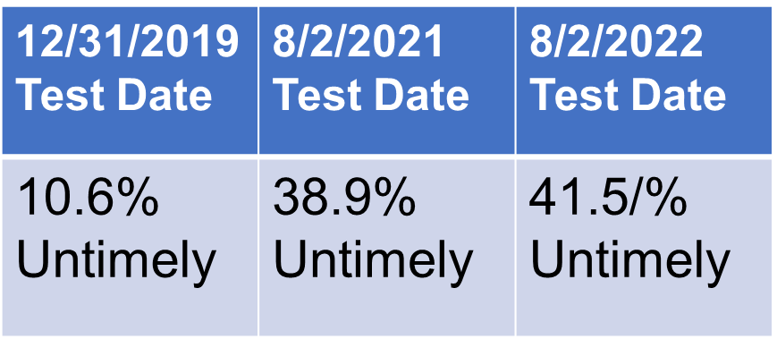
Overall Ongoing Grantee Compliance
For the majority of grantees, timely expenditure is not an issue
December 31, 2019, last test date before the pandemic
August 2, 2021, last test date before the corrective actions suspension was lifted.
Current status as of Spring 2023: 38.5% are untimely
Source: IDIS PR56 Report

Slide 14
What If a Grantee Is Untimely In FY23?
First-timers
Warning letter
Grantee given 12 months until its next test date to become timely.
Second-timers
Warning letter with the requirement to submit a workout plan.
Grantee given 12 months until its next test date to become timely.

Slide 15
Workout Plan Resources
From October 2002, but still a valuable resource (Search for “CDBG Timeliness Workout Plan” to find it.)
Follow the guidance provided
Make sure your workout plan includes a projected vs. actual funds drawdown spreadsheet – cash flow projection

Slide 16
Oh No! Third Time Untimely! The Informal Consultation with HUD HQ
Grantees receive a letter from HUD HQ.
Meet virtually with the CPD Deputy Assistant Secretary for Grant Programs.
“Make your case” for circumstances beyond your reasonable control that made you untimely
NO Guarantee that you will be granted an exception!
Your Field Office’s analysis and recommendation.
Will address your efforts to become timely in the past 3 years.

Slide 17
What happens if HUD doesn’t accept my reasons....?
SANCTIONS
Taken from the forthcoming grant.
Never exceeds the full grant amount.
HUD may also grant an exception to the standard based on the circumstances set forth by the grantee as beyond its reasonable control.
Example:
Annual grant = $1 million
60-day adjusted ratio is 1.57; adjusted line of credit is $1,570,000
The maximum amount of the reduction is $70,000
(1.57 - 1.50 = .07) x $1 million = $70,000

Slide 18
What About CDBG-CV Funds??
CDBG-CV funds are excluded from the CDBG Timeliness adjusted ratio.
BUT!!
Remember that Program Income from CDBG-CV projects accrues to the grantee’s adjusted line of credit and will be calculated in the grantee’s adjusted timeliness ratio.

Slide 19
Ideas for Staying or Becoming Timely
Grantees can:
#1! Seek and Accept Technical Assistance!
Monitor your timeliness throughout the year
Build timeliness into the process of determining what activities to fund
Consider phasing larger projects or pursuing a Section 108 loan
Develop contingency plans in case of project delays
Reprogram funds from slow-moving projects
Consider incurring pre-award costs
Actively manage program income and keep track of CDBG-CV program income.
Use the PR59 report for At Risk Activities.

Slide 20
Resources for Keeping Your Grant Funds Moving
Keeping Your CDBG Funds Moving is a pamphlet that is helpful when grantees review internal procedures to incorporate timeliness into day-to-day operations.
Developing and Implementing a CDBG Workout Plan provides guidelines for preparing a workout plan acceptable to HUD.
Ensuring CDBG Subrecipient Timeliness provides guidelines for grantee selection, management, and oversight of subrecipients in the CDBG Program.

Slide 21
Other Resources
An excellent introduction to the timeliness process and best practices to achieve timeliness can be found on the “Explore CDBG” page on the HUD Exchange. (click on the video below to watch.)

Slide 22
Questions?

